Slide 1


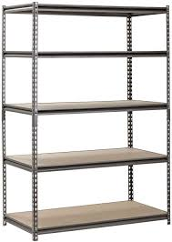


By Aric Rachmany and Tal Kabaso

Slide 2

The idea behind the project
As part of the Economics Algorithms course, we have produced lots of controversy and optimization solutions that fit a wide range of areas in life.
We decided to take the subject of the exchange of objects and make it something tangible that could be used and not just recognized as a theoretical solution.
Almost every person has old items that he no longer needs but now he can easily replace them and get very valuable items for him, so that other people will enjoy his item.

Slide 3

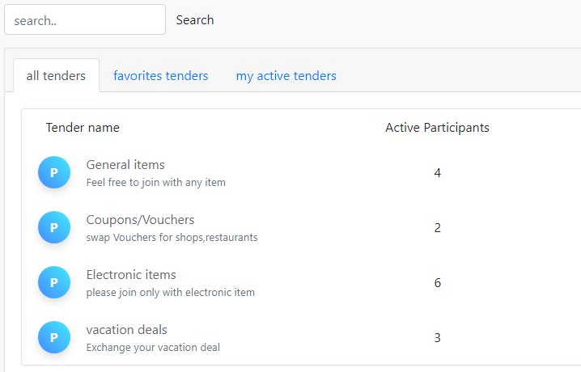
Why our site is better than other exchanging items sites?
Currently, there are interfaces that allow the exchange of items between 2 people, selling and buying products via the Internet, however in our site we allow users to get new items for them without the need of searching separately seller and buyer.
in addition there is no limit on the number of participants, thanks to the algorithm we use, that looks for as many swap circles as possible at each stage among all tender participants.

Slide 4
Why to use our site?
Our site offers comfortable and user-friendly UI in the form of a website to enable people to get valuable items for them instead of items they no longer need.
The number of participants is unlimited which increases the chances of finding an item that I like and increases the likelihood of an exchange.
Each user should tell his true preferences in order to increase his chances of getting one of the products he prefers.
We used a familiar algorithm called "trading cycles“, That has some notable advantages:
Allow us to assure users that they cannot lose from participation.

Slide 5
In order for a user to enjoy the services of the site he need to register and then he will have options such as creating a tender, managing the tenders he owns, adding and editing items within his collection, entering a tender with one of his items and more.
Once a person enters the tender with an item, he can change the item without leaving the tender, leave the tender before the algorithm starts or share the tender with friends via the WhatsApp application.
Once the tender registration period is over, participants will not be able to exit the tender or change the item, but will be required to rate the products they want to get instead of their item conveniently by dragging the products they are interested in, to the wish list from top priority to lowest priority. When our product is automatically ranked after the last product in the wish list.
Once the ranking time is over, users will have to wait for the results that will usually be received by mail the day after the end of the ranking period.
Instructions

